Slide 1
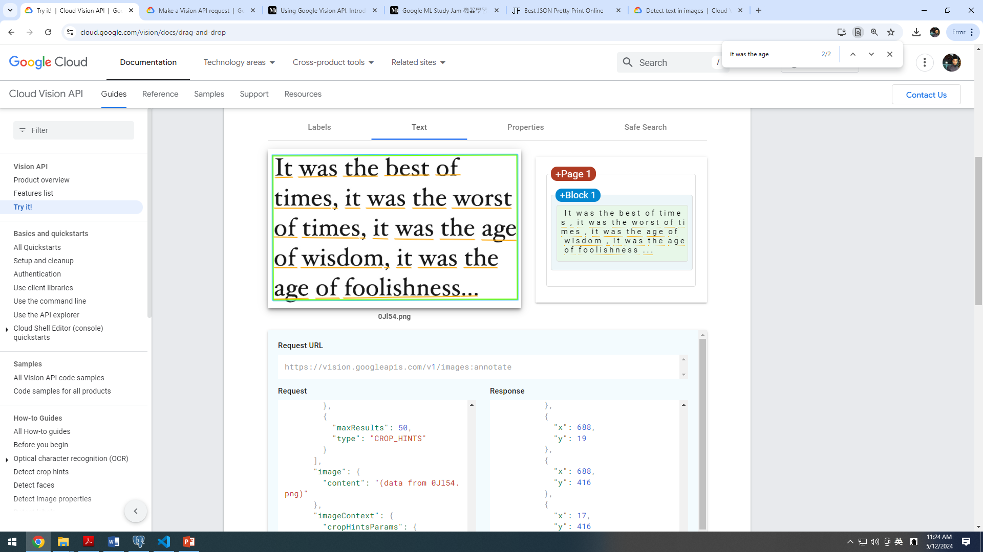
https://cloud.google.com/vision/docs/drag-and-drop

Slide 2
TYPE_UNSPECIFIED
FACE_DETECTION // Part 2
LANDMARK_DETECTION
LOGO_DETECTION
LABEL_DETECTION // Part 1
TEXT_DETECTION // !!!
DOCUMENT_TEXT_DETECTION // !!!
SAFE_SEARCH_DETECTION
IMAGE_PROPERTIES
CROP_HINTS
WEB_DETECTION
PRODUCT_SEARCH
OBJECT_LOCALIZATION
request_body = {
requests: [
{
image: {
content: base64ImageStr, // this need to be base64 string
},
features: [
{
type: "LABEL_DETECTION",
},
],
},
],
};

Slide 3
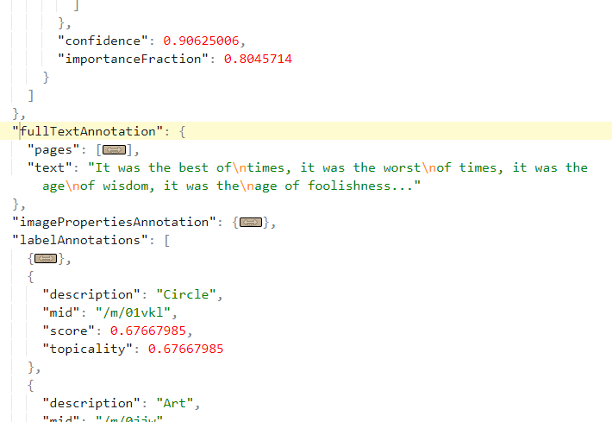
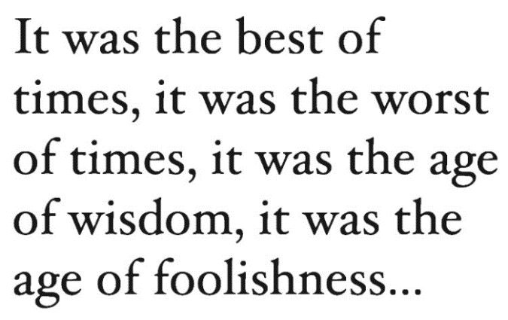
https://cloud.google.com/vision/docs/ocr
request_body = {
requests: [
{
image: {
content: base64ImageStr, // this need to be base64 string
},
features: [
{
type: " TEXT_DETECTION ",
},
],
},
],
};
Method 1
const response = await axios.post(
`https://vision.googleapis.com/v1/images:annotate?key=${apiKey}`,
request_body
);
const result = response.data;
const full_text_annotations = result["responses"][0][“fullTextAnnotation"];
full_text_annotations[“text”]; // this is text detection result!

Slide 4
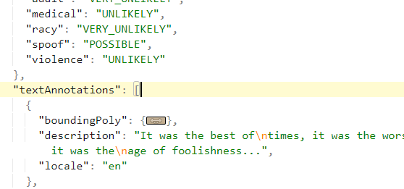
https://cloud.google.com/vision/docs/ocr
request_body = {
requests: [
{
image: {
content: base64ImageStr, // this need to be base64 string
},
features: [
{
type: " DOCUMENT_TEXT_DETECTION ",
},
],
},
],
};
Method 2
const response = await axios.post(
`https://vision.googleapis.com/v1/images:annotate?key=${apiKey}`,
request_body
);
const result = response.data;
const text_annotations = result["responses"][0][“textAnnotations"];
text_annotations[“description”]; // this is text detection result!

Slide 5
https://medium.com/@annycarolinegnr/using-google-vision-api-22d1fdb755d8
https://medium.com/@kcchien/google-ml-study-jam-%E6%A9%9F%E5%99%A8%E5%AD%B8%E7%BF%92%E7%AD%86%E8%A8%98-02-%E4%BD%BF%E7%94%A8-cloud-vision-api-%E4%BE%86%E5%81%B5%E6%B8%AC%E5%9C%96%E7%89%87%E4%B8%AD%E7%9A%84%E6%A8%99%E7%B1%A4-%E8%87%89%E5%AD%94%E4%BB%A5%E5%8F%8A%E5%9C%B0%E6%A8%99-4316b30d62fe

Slide 6
RESTFUL API
https://learning.postman.com/docs/sending-requests/create-requests/generate-code-snippets/
NodeJS client library
Python client library
xxx programming client library…

Slide 7
HTTP Status Code 200 vs 201
https://developer.mozilla.org/en-US/docs/Web/HTTP/Status

